Slide 1

Annotation Service: REST API
By: Alba Nagel

Slide 2


Index
REST API?
Elements of REST
Annotation Service REST API in NGS
VEP
Connected to other parts?

Slide 3
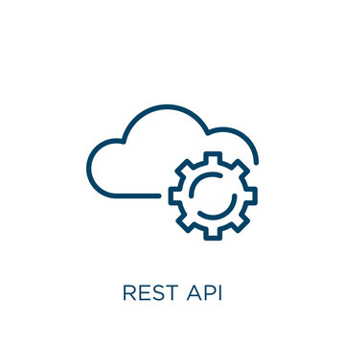
REST API?
REST API: Representational State Transfer Application Programming Interface
API that implements REST endpoints (methods) → allow requests from (web) clients (HTTP protocol) through implemented business logic
HTTP methods that might be used:
GET: retrieve a resource
POST: create a resource

Slide 4
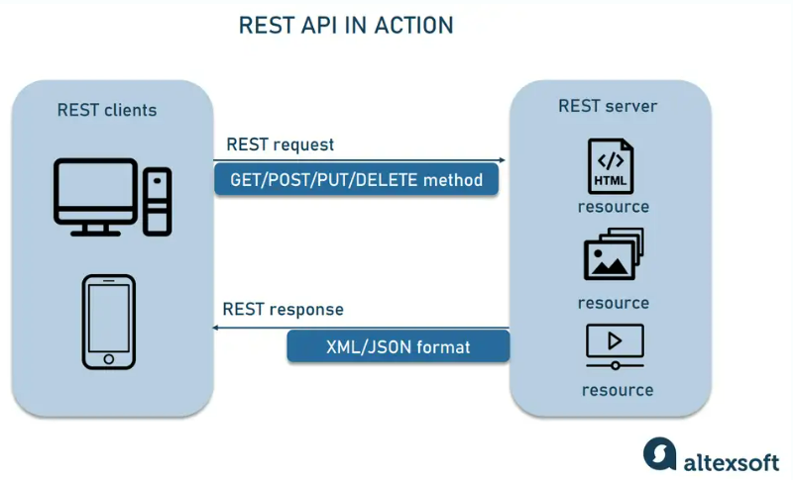

Slide 5
Elements of REST
Client/Software: runned on a user’s device → it starts communication
Server with API to access its resources
Resource → content that server provides to client (e.g. genomic data, annotations)
To access ---> client sends HTTP request
Server then creates HTTP response
REST request
HTTP method
Endpoint: has a URI (Uniform Resource Identifier) → shows where + how to find resource on internet (most common is URL)
Headers: save information important for client + server
Provides authentication data (API key, IP address of computer with installed server + information about response format)
Body: for adding more information to server (e.g. data to add/replace)

Slide 6
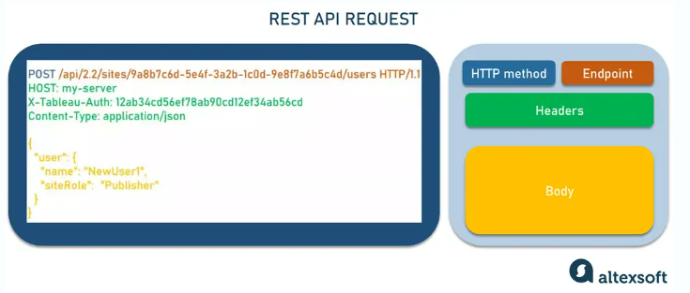

Slide 7

Annotation Service REST API in NGS
Web-based service → provides functional annotations for genetic variants (obtained from NGS data)
1 type of annotation service is VEP (Variant Effect Predictor)
shows functional annotation (e.g: how variants in proteins/genes affect their function/possible diseases)
VEP can be used through REST API → it provides endpoints which let users submit genetic variant data + receive annotated results with HTTP requests (GET + POST)
ENSEMBL: provides data for VEP to annotate
Variants should be in VEP Format (like VCF Variant Call Format)
From the part NGS data analysis we will get FASTQ files→ convert to VCF, later to JSON format

Slide 8
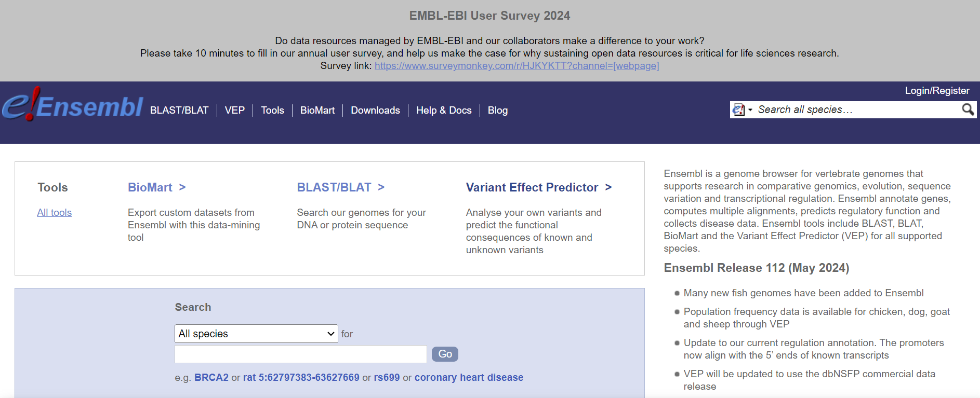
VEP

Slide 9
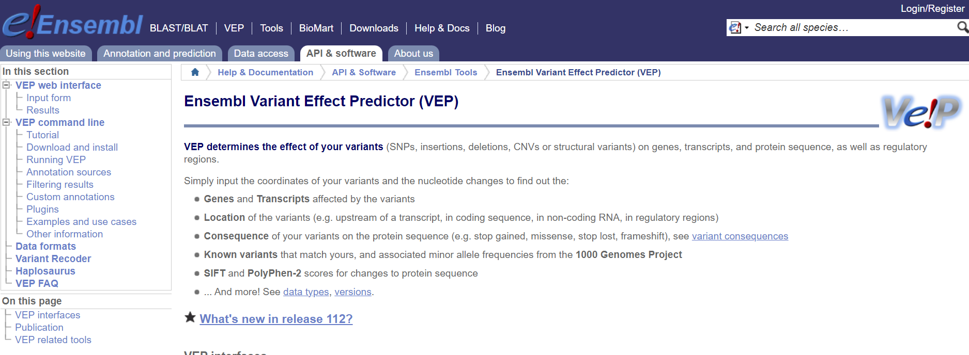
VEP

Slide 10
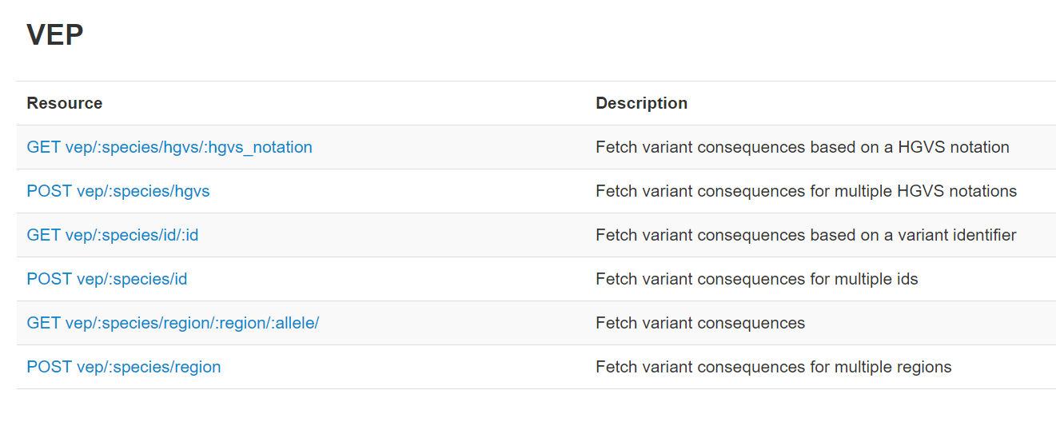
VEP

Slide 11
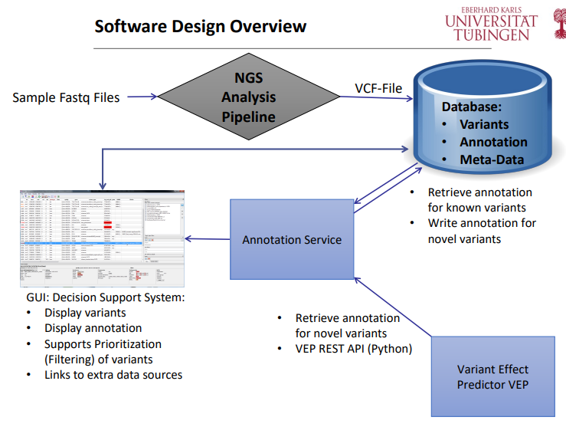
How is it connected to the other parts?
Direct contact with Database (VCF-File → received from NGS Analysis Pipeline)
In between GUI (which must be able to display variants, annotations, etc. …) and server developed by REST API
Our server should be able to use VEP for getting annotation of variants

Slide 12
Bibliography
https://www.altexsoft.com/blog/rest-api-design/
https://stackoverflow.blog/2020/03/02/best-practices-for-rest-api-design/
https://www.ensembl.org/info/docs/tools/vep/index.html
Prof. Ossowski’s Präsentation

Slide 13
Thank you for listening!

